Slide 1

Automobile Service and Product Management System
Group CS-45

Slide 2
Group Details
Supervisor
Dr. (Ms) K.H.E.L.W Hettiarachchi
Group Members
N. S. Elvitigala - 20000480
B. A. Sathyanjana - 20001681
E. S. D. Senewirathne - 20001738
T. H. T. C. Gunathilaka - 20000652
Co-supervisor
Mrs. Hirasha Pooliyadda

Slide 3
Introduction
We plan to make an Automobile service and product management system, which can manage customer
appointments
service and repair workflows
product orders
in one system.

Slide 4

Project Description
Web application system for manage automobile service/repair and auto-parts
Unregistered customer only can view the services and auto-parts
Unregistered customers can be promoted as a registered customer after creating an account
Registered customer can make an appointment for service/repair and order an auto-parts
Managing transactions through online payment
Service workflow is also managed from the system

Slide 5
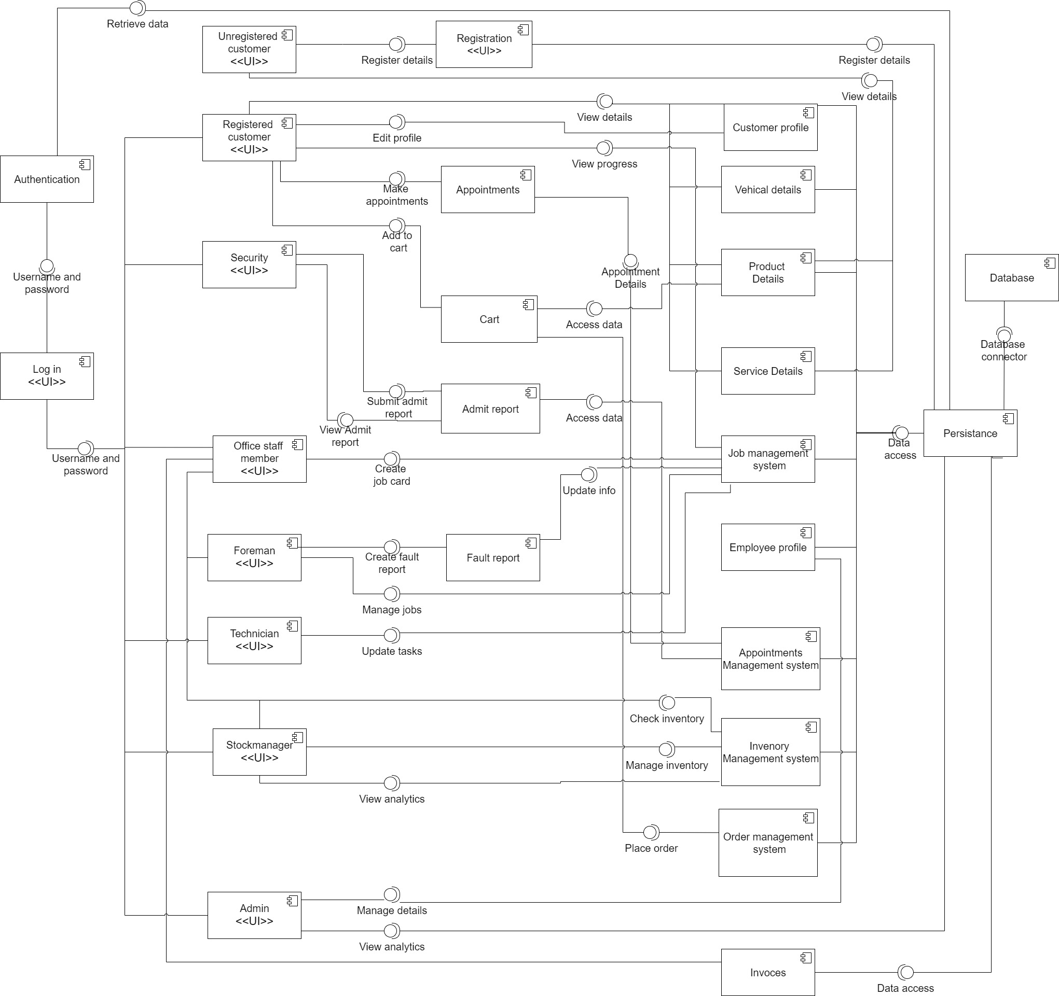
High-level System Architecture

Slide 6
Workload Distribution
Nethsara: Activity diagrams, narratives for the stock manager, admin
Avishka: Activity diagrams, narratives for Foreman, technician
Supun: Activity diagrams, narratives for security, office staff member
Tharushi: Activity diagrams, narratives for the customer, logged-in customer
Everyone joined the use case, component diagram, and proposal content

Slide 7
User Identification
Customer
Stock Manager
Admin
Technician
Security Officer
Officer Staff
Foreman

Slide 8
Functional Requirements

Slide 9
Customer (Unregistered)
Search products
1
Search services
2
View ratings & reviews
3
Create user accounts
4

Slide 10
Search products
Search services
View ratings & reviews
Log in to the account
Reset account password
Manage cart (add, remove, view items)
Buy products (making payment)
View past, pending orders
Post rating & review
Make appointments
Check appointment details
View the progress of long-term service/repair
View past service & payment history
Customer
(Registered)

Slide 11
Manage inventory (View, Add new products, Restock. Delete, Update products)
Check ordered products
View product reviews
Analyze sales
Manage suppliers (View, Add, Update, Delete)
Manage inhouse distribution
Stock Manger

Slide 12
Admin
Create employee accounts
1
Delete employee accounts
2
Update employee accounts
3
Change employee account passwords
4
Generate analytic reports
5

Slide 13
Technician
Update service/repair progress
Request spare-parts

Slide 14
Security Officer
Check appointment details
Give access to the vehicle
Generate admitting report at the beginning
Check admitting report at the end

Slide 15
Officer Staff
View customer details (service & payment history)
Create customer account
Make an appointment
Generate an invoice

Slide 16
Foreman
Generate fault report
Check availability of the parts
Generate cost estimation report
Generate a quotation
Check vehicle history
Assign technicians

Slide 17
Quality Attributes
Availability
Modifiability
Security
Performance
Testability
Usability

Slide 18
TECHNOLOGIES

Slide 19






Front – end development
Database
IDE
Back – end development
Development server

Slide 20





Project management tool
Storage for document
Version control and collaboration
Diagram drawing tool
Team meetings

Slide 21
Feasibility Study
Social
Technical
Economic
Legal & Ethical
Operational

Slide 22
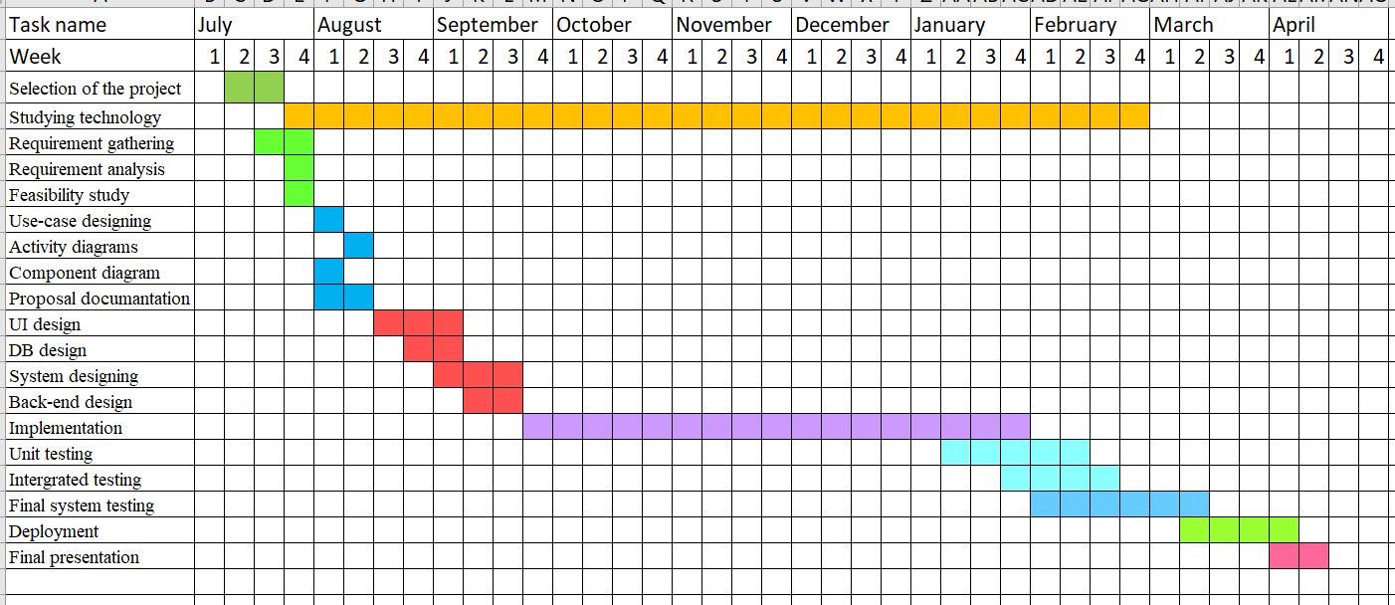
Project Timeline

Slide 23
Limitations & Constraints
All the users must have an internet connection to connect to the system as this is a web-based system
Customers cannot cancel the orders after the products are on the way
Cash payments are not handled via the system
Appointment rescheduling is not possible

Slide 24

QUESTIONS?

Slide 25
Thank You

